Slide 1
Techniques & tips to develop listening skills for multi-level learners
Martin Sketchley
25 September 2018

Slide 2
About me

Slide 3
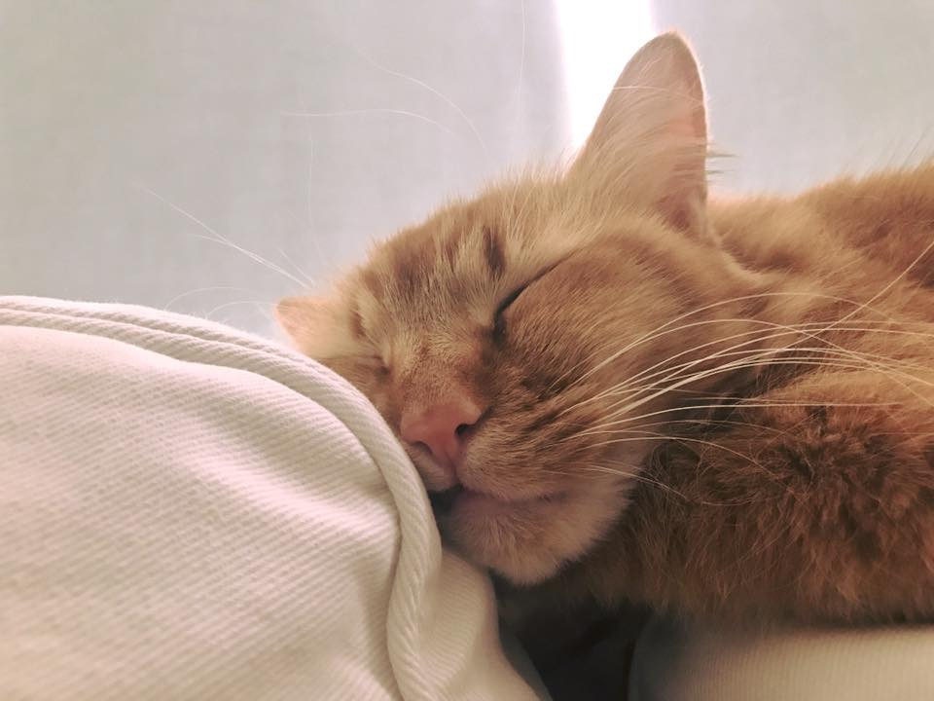
About me

Slide 8
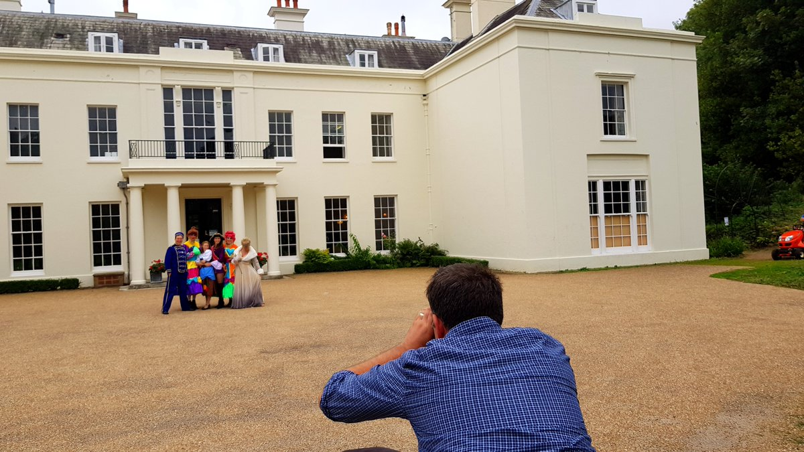

Slide 9
What do You remember?
What is the name of my cat?
How long have I been teaching English?
Where have I taught English?
Where do I live now?
How long did I live in Korea?
Where do I teach now?
Mittens
For over 12 years.
In South Korea, the UK & Romania
Eastbourne
For three years
LTC Eastbourne

Slide 10
Aims for today
The reasons for teaching listening skills
Evolution of listening in the English classroom
Common problems encountered by learners
Practical listening activities to incorporate into lessons
Activities teachers could incorporate outside the classroom

Slide 11
Discussion time
How often do you incorporate listening into your lessons?
What are your favourite listening activities?
How do you feel about the teaching of listening in class?
What makes a successful listening lesson?
What type of structure do you normally follow when teaching a listening focused lesson?
How do you feel listening has developed with language lessons?

Slide 12
The evolution of listening in the English classroom
What different approaches to listening skills are you aware of in the classroom? Which ways has it changed over time?
Translation & Interpretative: the teacher utters something in L1 and students respond in L2
Drill & Repeat: students listen to the teacher and repeat
Automated Responses: students respond to input - the “How are you?” analogy
Situational: at the train station, making a complaint on the phone, etc.
Authentic: movies, podcasts, YouTube videos, etc.

Slide 13
Why teach listening?
In small groups or pairs, write down as many reasons why teachers should teach listening in the classroom.
Listening is rarely accounted for any initial assessment in schools, with grammar being the primary tool
Students tend to blame themselves if they are unable to comprehend an utterance
Lack of listening ability exacerbates the reduction of confidence

Slide 14
What makes a listening lesson successful?
Discuss in groups what would make a successful listening lesson.

Slide 15
What makes a listening lesson successful?
Relevance of material
Contemporary quality (is it relevant today?)
Use of authentic material
Purpose of listening
Anticipated issues of listening
Interest with listening material
Mental fatigue

Slide 16
What are the typical stages of a listening lesson?
The following listening lesson is out of order. Work with a partner and try to figure out the stages of the listening lesson.
The following order is:
i, f, e, a, g, b, h, c, d
The stages a, b and c are obviously interchangeable.

Slide 17
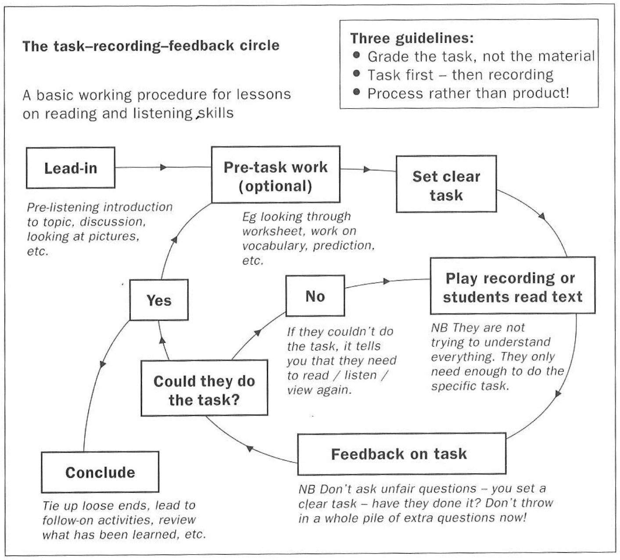
The task-feedback circle
Teachers using a graded sequence of tasks as a route through listening would benefit students. Firstly, starting off with a simple task, moving onto more complex and demanding tasks will ensure that student confidence is developed.
Using this approach will ‘let the class find its own level, ie you stop setting new tasks when you find the point at which they are beginning to find it too difficult’ (Scrivener 2011, p.253).

Slide 18
Three stages of listening tasks
Pre-Listening: prepare students for the listening task
During-Listening: students complete tasks during the listening
Post-Listening: the teacher takes learners beyond the listening and use it to springboard further language practice

Slide 19
Discussion: listening skills
Discuss the following questions together.
What listening could be incorporated inside or outside the classroom?
What ways have you experimented with more adventurous listening during lessons?
What is your usual method of listening in the classroom?
How many times would you let students listen to an audio?
Which ways would you demand more from learners with listening skills?
How would you assess listening comprehension in class?

Slide 20
Listening inside the classroom
Coursebook audio: tapes, CDs, MP3, etc.
Story telling
Reading aloud / Instructions
Conversations between learners
Film & Video
Dictation
Music

Slide 21
Listening outside the classroom
Podcasts: ESLPod.com
English movies (Netflix) or music (Spotify) without subtitles in either L1 or L2
Internet radio: www.bbc.co.uk/radio
ESL Lab: www.esl-lab.com
YouTube: www.youtube.com
Breaking News English: www.breakingnewsenglish.com
Functions: at a restaurant, in a shop, etc.

Slide 22
Common issues with listening for students
What common issues do students have with regards to listening? Discuss with the person next to you.
Lack of awareness with schemata (vocabulary for the topic)
Pronunciation issues: connected speech, accent, speed, intonation, etc.
Mixing up the stages of a listening lesson
Jumping between gist and detailed listening tasks
Mental fatigue
Lack of learner practice

Slide 23
adventurous ideas for listening in class

Slide 24
1. Coursebook audio
What creative ways could you use coursebook audio in class? Discuss in pairs.
Show pictures and get students to guess the sequence before listening: eg. a story, sequence of events, etc.
The teacher shows different pictures related to the listening and students predict the story.
Devise a series of true and false statements with learners having to listen in detail and then decide.
Cut up the script, hand it to students, they listen to the audio, place it in order and then check again.
For stronger learners, give them comprehension questions. For weaker learners, hand the questions plus the script. They answer the questions and then pair up strong to weak learners to check their answers.

Slide 25
2. Story telling
What creative ways could you use storytelling in class? Discuss in pairs.
Tell a story and then stop at an exciting point and then get students to guess what happens next.
Once you have told the story, students recall the story to each other.
Use images to help tell the story. This will support lower level learners with their schemata while listening.
Get students to tell a story related to something you told them (personalisation)!

Slide 26
3. Reading aloud
How would you get students involved in reading? Discuss in pairs.
The teacher could read a story or a piece of text with conviction and style for learners to hear the real word spoken naturally.
After you demonstrate the story or dialogue, you could put students into groups to practice telling the story using the correct intonation and stress forms.
Feedback and correction could be provided after read the dialogue/story in small groups.
Do not just get students to read a text with no immediate reason. Question why you are doing it. What is the benefit?

Slide 27
4. Interviews / conversations
Tell students that you will be inviting someone (a colleague or friend) into the class and that you will be having a conversation about a topic.
Get students to think of vocabulary related to the topic activate schema.
After the brief conversation between you and the invitee, students work together and think of questions to ask.
Students then hold an interview with the person who has been invited to the classroom about the topic spoken about.

Slide 28
5. Films & videos
Have you ever used films or videos in class? Was it successful? Discuss in pairs.
Pictureless Listening: the teacher covers the screen, turns the monitor away or turns the brightness down. The students listen to the dialogue and have to think about location, speakers, etc.
Freeze Frame: at any stage during the video, the teacher pauses it, and then asks the students what they may think will happen next. Play the video after some predictions and then compare. Continue throughout the video.
True or False: as students watch the video, they answer potential comprehension statements with either ‘true’ or ‘false’.
Character Descriptions: compile some photos, names and background info about the main character from a movie or drama series. Get students to match the information with the character.

Slide 29
6. Songs in class (1)
How would you use songs in class? Share your ideas with others.
Ordering Lyrics: cut up the lyrics and then students have to reorder them.
Correct Word: when preparing lyrics, you could then give students one of two words to choose. They have to choose the correct word.
Correct Mistakes: students have to listen to the song and then compare with the lyrics and find mistakes. Once they have found any mistakes, then learners should correct them.
What’s The Topic?: choose three songs which are connected to the topic. Play each song for 20-40 seconds each. Students must guess the topic of the day.

Slide 30
6. Songs in class (2)
Extra Words: add some extra words to the lyrics which you hand out to students and ask them to cross out these extra words.
Bingo: hand out a bingo sheet (4 by 4 grid) with words from the song on it (different for each student or you could dictate words and students write them randomly on the blank bingo sheet). Students then cross out words that they hear and once they complete a row down or across, they shout ‘Bingo!’

Slide 31
6. song in class: Practice (3)
You will listen to a song. When you hear a word, grab the word in front of you. Keep it. The person with the most words is the winner.

Slide 32
6. song in class: Practice (3)
Listen to the song again now and put the lyrics in order. Work in your small groups. I shall play the song once.
Imagine
Hell
People
Countries
Die
Religion
Peace
Dreamer
Only
Join
World
Possessions
Greed
Hunger
Brotherhood
Sharing

Slide 33
7. Flipped listening
Have you ever heard the term ‘flipped classroom’? What do you think ‘flipped listening’ is? Discuss in small groups.
Tell students that they need to complete a listening outside of class.
Give students the link to the listening via email or messenger and handout the comprehension task. However, the listening comprehension task could be online with Google Forms.
Students complete the listening outside of class in their own time.
Once students return the following day or for the next lesson, students complete a discussion related to the topic of the listening.
Students are expected to complete the listening task as part of their self-development and it would encourage students to become more anonymous learners.

Slide 34
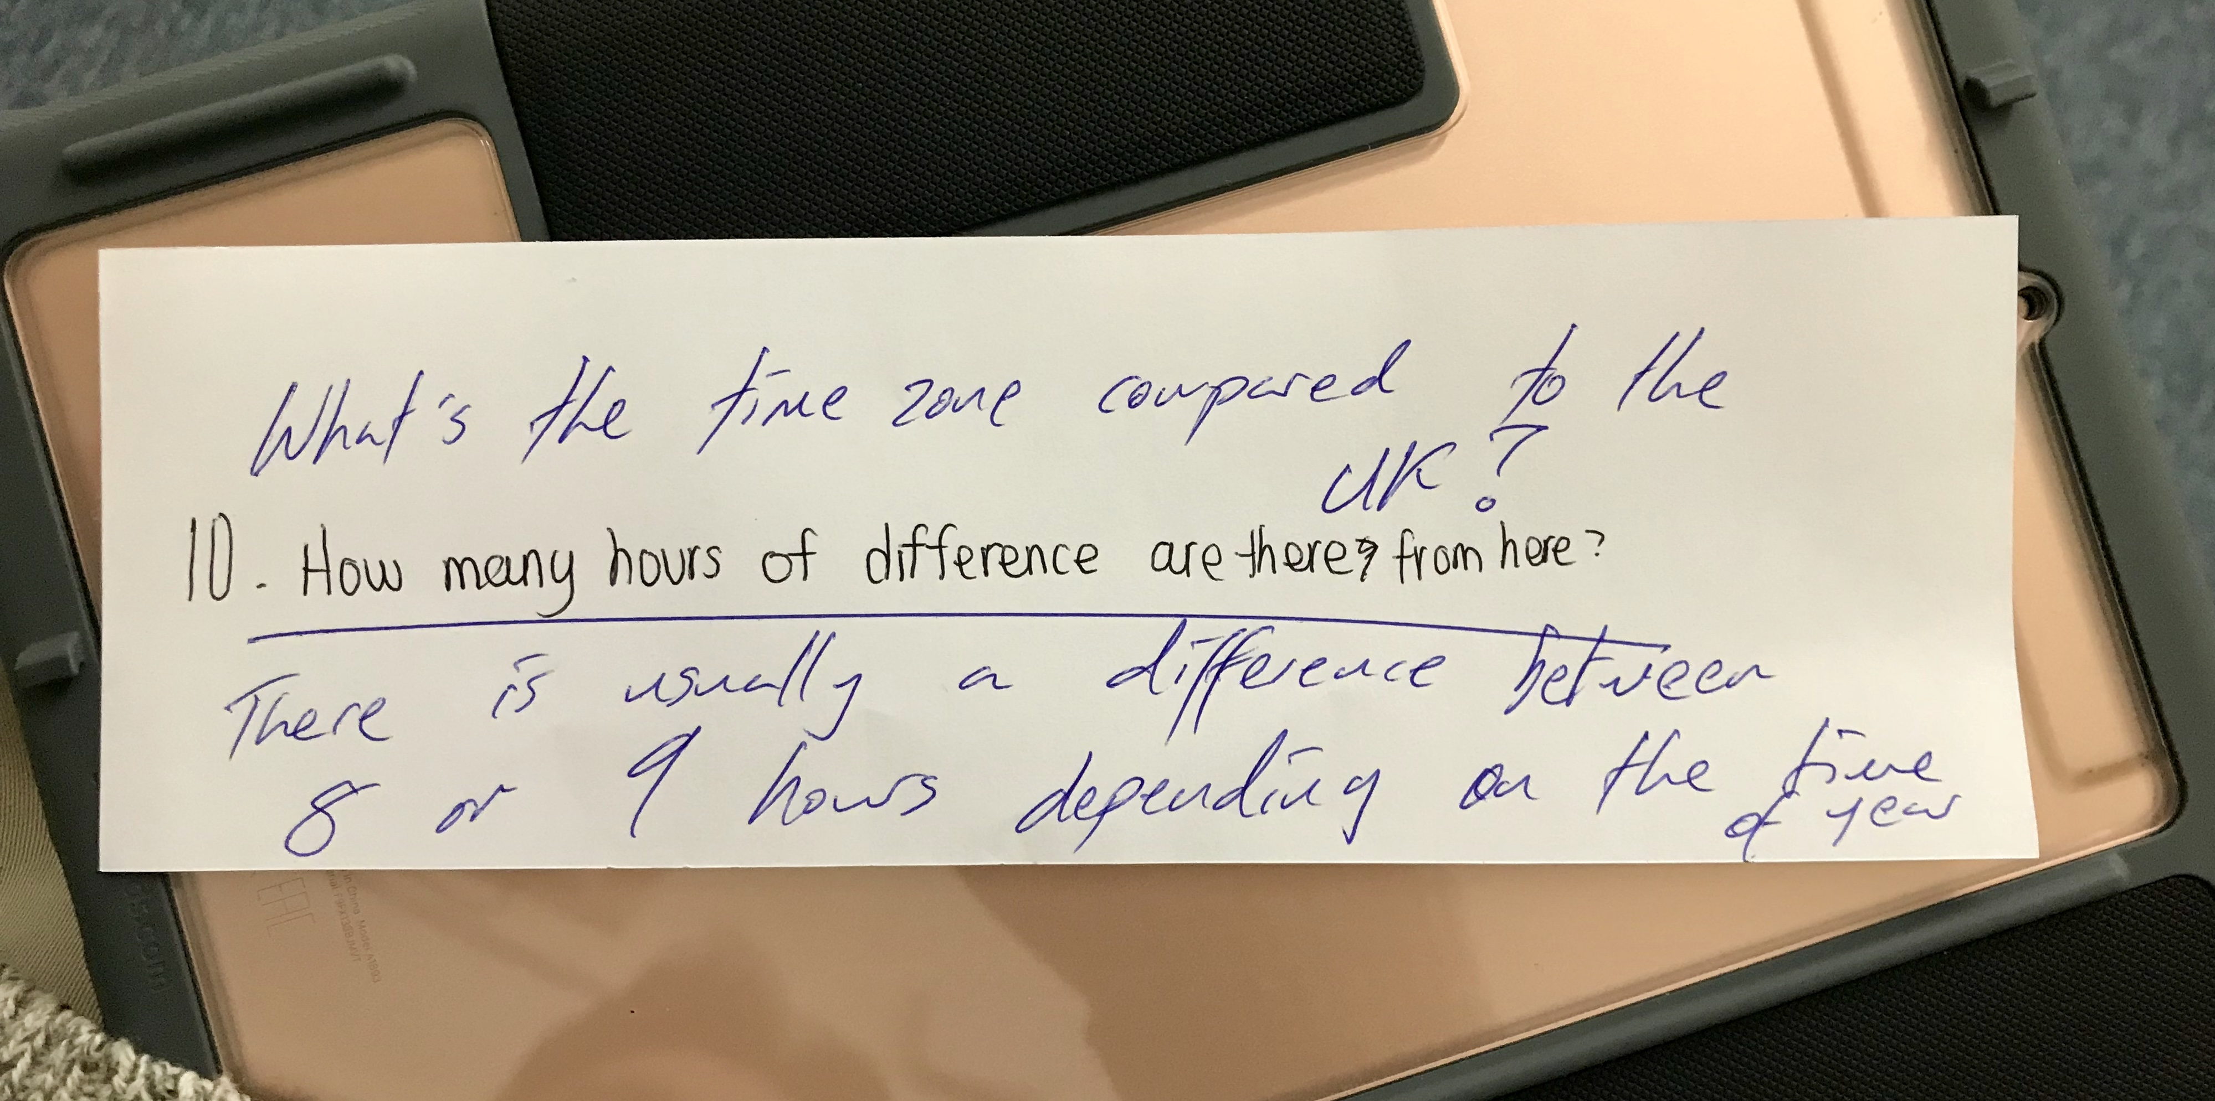
8. Student made questions
Pair up stronger and weaker learners together.
Hand out the script from the listening.
Tell groups of students that they must write comprehension questions together.
Give them some time and monitor where necessary.
Once groups of students have completed the task, collect the comprehension questions as well as the script and then redistribute questions to another group.
Students listen to the audio and then answer the corresponding questions.

Slide 35
9. AudioBooks
Prepare a library of books as well as audiobooks for students to borrow after lessons.
Dedicate one day for students to share ideas or opinions of books that they have been reading or listening to outside of class.
Encourage learners to develop listening awareness through the use of audiobooks by preparing a list of open questions:
What new word did you find difficult to pronounce when listening to your audiobook?
What audiobook would you recommend another student? Why?

Slide 36
10. Dictogloss
Have you ever heard the term ‘dictogloss’? Tell your partner.
Prepare a story (similar to idea number 2)
Tell students the story at natural speed three times
Each time the students write down particular words: verbs, nouns, etc.
After you’ve finished telling the story, students have to write the story
Compare student stories with the original
https://youtu.be/BFN2zw_A06s

Slide 37
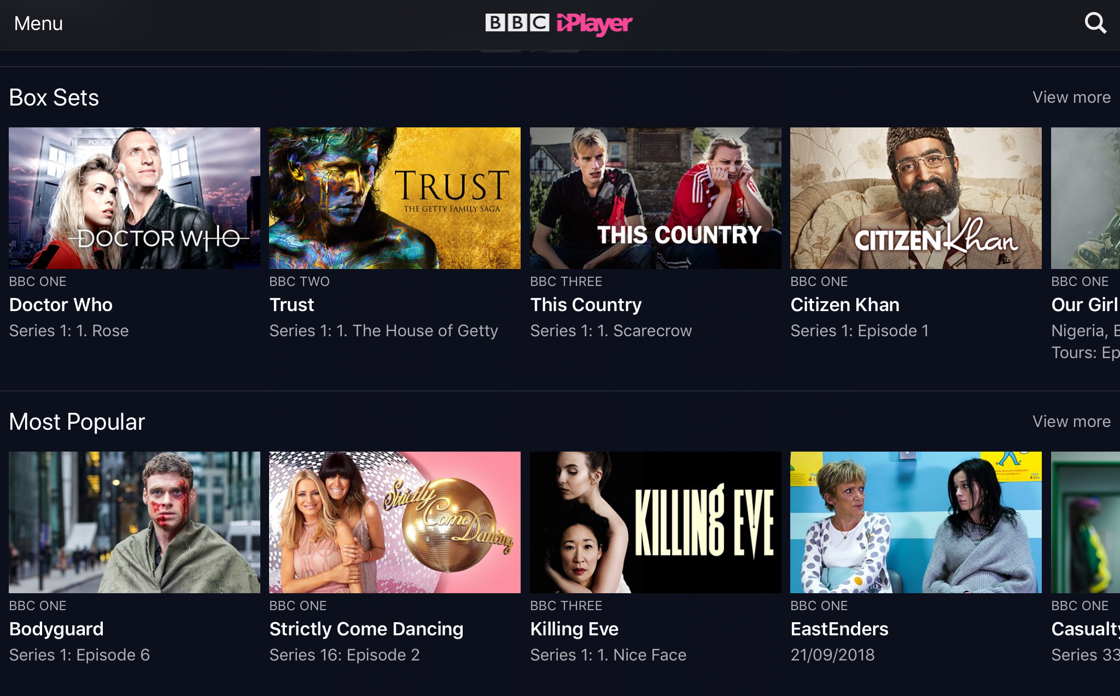
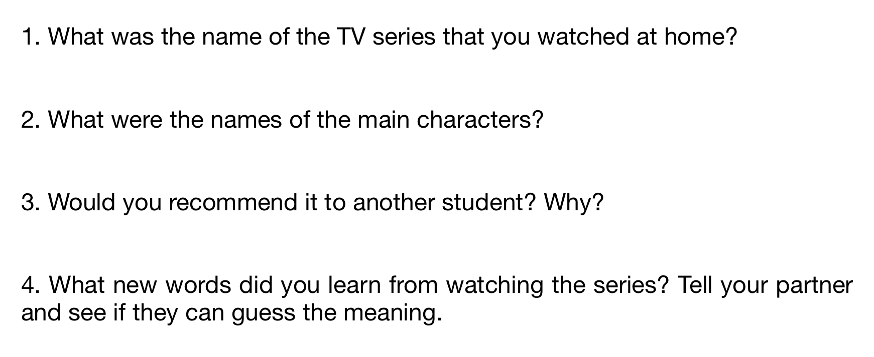
11. Streamed videos
What video streaming services are you aware of? How could you incorporate video streaming outside of lessons?
Translate subtitles from a learner’s L1 into English, then compare to the original English dialogue.
Prepare the script peppered with mistakes and learners must listen to the scene and then correct the script.
Students watch the trailer silently and then they must write a voiceover to go with the trailer.
Get students to watch one episode of any TV series without subtitles when they are at home and when back in class they must discuss about it with another student.

Slide 38
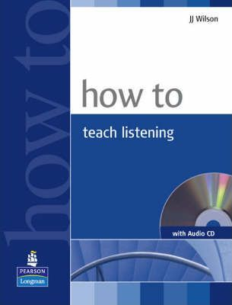
Additional reading

Slide 39
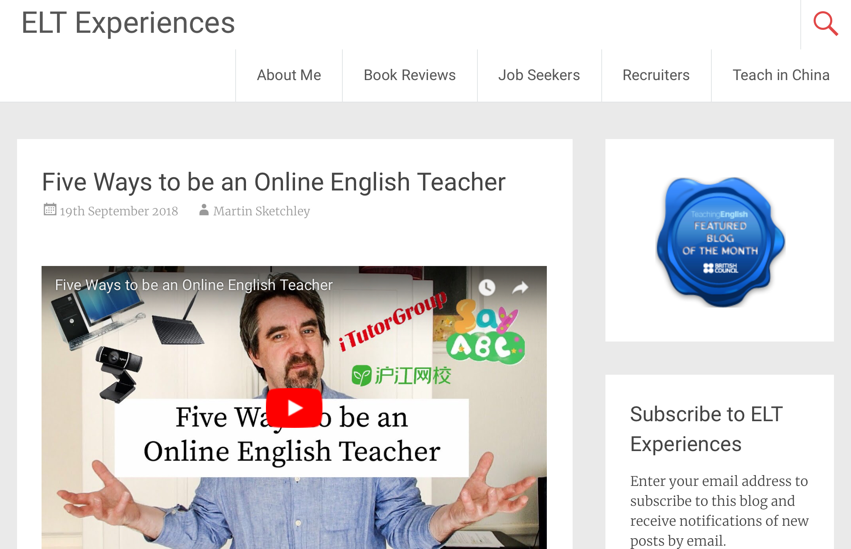
Online handouts
ELT Experiences: www.eltexperiences.com
Twitter: www.twitter.com/ELTExperiences
YouTube: www.youtube.com/ELTExperiences
Email: martinsketchley@eltexperiences.com

Slide 40
Any questions?

